Slide 1
AAA School safety patrol program
During covid-19

Slide 2
**Presenter Notes**
**Prior to presenting, locate this slide on the left menu,
right click on the slide and select “Hide Slide” **
This presentation is intended to provide Patrollers with information for participating in the AAA School Safety Patrol Program during COVID-19.
This presentation includes:
Size of Patrol; Considerations based on where Patrollers are posted
Guidance for Patrol meetings
Extra opportunities for Patrollers
Patroller Reminders
Patrollers should not enforce public health measures like use of face coverings, social distancing or hand hygiene while on duty.
Notes:
The AAA School Safety Patrol is about being a good leader and willing to work hard to help others. Many important individuals throughout our history started their first leadership position as a AAA School Safety Patroller.
AAA School Safety Patrol Famous Former Patrol Members
For some, being a member of the AAA School Safety Patrol is just the first step toward a career of public service and leadership. Former patrol members include:
Governors and Former Governors Bob Martinez, Florida James Blanchard, Michigan William Milliken, Michigan Lincoln Almond, Rhode Island
21 Astronauts, including: Norman E. Thagard, space endurance record holder Robert D. Cabana Mary Ellen Weber
U.S. Presidents/Vice Presidents Jimmy Carter, Bill Clinton, Joe Biden
U.S. Senator John W. Warner, Virginia
U.S. Supreme Court Justices & Former Justices Chief Justice Warren E. Burger, Anthony M. Kennedy, Stephen G. Breyer, Clarence Thomas, William J. Brennan, Jr.
Olympic Gold Medalists Caitlyn Jenner, decathlon Lynette Woodard, basketball Mike Ramsey, hockey Eric Heiden, speedskating Edwin Moses, track and field
Nobel Prize Winner Dr. Gary S. Becker, Economics
Government Andrew Card, Chief of Staff to George H. Bush and George W. Bush and former U.S. Secretary of Transportation U.S. Coast Guard Rear Admiral James C. Card, Office of Marine Safety,
Security and Environmental Protection Diane Steed, former administrator National Highway Traffic Safety Admin. Mike McCurry, former White House Press Secretary
Celebrities Joe Garagiola, Baseball Hall of Famer Tom Seaver, Baseball Hall of Famer Margaret Ay, Miss America 1954 Al Kaline, Baseball Hall of Famer Lee Iacocca, former Chairman Chrysler Corporation

Slide 3
**Presenter Notes Continued**
**Prior to presenting, locate this slide on the left menu,
right click on the slide and select “Hide Slide” **
Patrol advisors should educate Patrollers about the importance of public health measures and reducing the spread of COVID-19.
Patrollers should NOT enforce public health measures.
Patrollers should practice countermeasures while on duty to set an example for classmates; shows respect for health and safety of those in their community.
Patrol advisors are encouraged to follow CDC recommended actions:
Promote behaviors to reduce the spread
Maintain healthy environments
Maintain healthy operations
Prepare for when someone gets sick

Slide 4
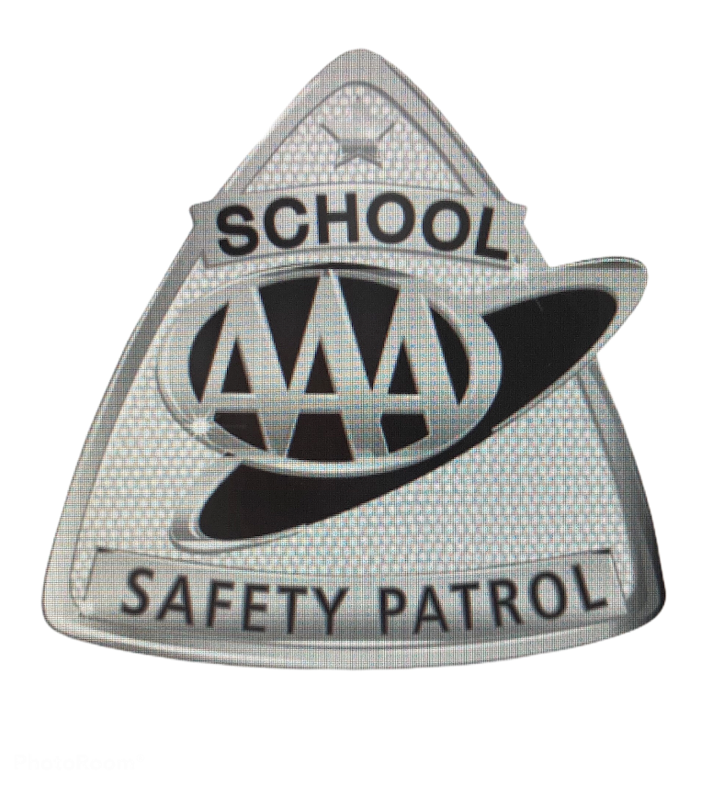
Ability to Adapt
The AAA School Safety Patrol program has survived for 100 years because it has evolved when needed.
This school year may look a bit different but as a Patroller, you will play an important role in the safety and well being of your peers.

Slide 5
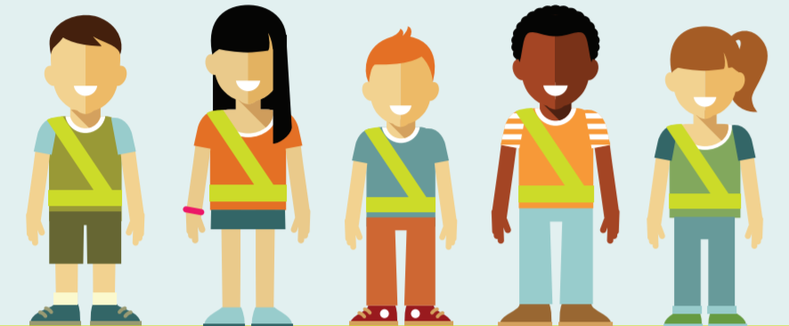
Size of the Patrol
The Patrol may be smaller if less posts are needed due to social distancing.
The Patrol may be larger if our school institutes an every other day schedule.
Substitute Patrollers may need to be on standby should a Patroller become ill.
Patrollers will need to be able to adapt to changes as they occur throughout the school year.

Slide 6
New Posts
There may be times this school year when social distancing is required.
Some traditional posts may not be possible.
Let’s talk about what new posts may look like.

Slide 7
Classroom Post
Safety Rules
1.
2
3.
Classroom posts will operate once or twice during the day depending on need.
Patrollers will perform a daily check for supplies:
Hand sanitizer, soap, disinfectant wipes, paper towels, tissues, masks, etc.
Patrollers will also help remind students to follow school safety rules (old and new)

Slide 8
Drop-Off/Car Rider Posts
Patrollers stationed outside assisting car riders should:
Maintain at least a car length’s distance between each Patroller
Patrollers should stand 6-feet away from the vehicle
Observe students as they enter/exit the vehicle but do not assist
Thank the driver with a hand signal or verbal command to indicate the student is clear of the vehicle

Slide 9
School Bus Post
School bus seating arrangements may look different this year.
Patrollers will act as a second set of eyes and a resource for students on the bus.
As always, Patrollers should never move around the bus while it is in motion and always practice safe behaviors.

Slide 10
Communications Post
Patrollers may participate in school wide announcements to educate students about safe behaviors.
Patrollers will work with the principal and/or media team on messaging.
Patrollers may be regularly present during a.m. and p.m. announcements.

Slide 11
Patrol Meetings
Monthly meetings may be virtual or held outdoors if conducted in-person.
Patrol officers should plan an agenda focused on old and new Patrol business, including updates about COVID-19.

Slide 12
COVID Guidance for Patrols
As a Patroller, you should not come to school if you or your family members are sick.
Know the back-up plan for Patrol posts if someone is out.
Ensure that Patrol equipment is wiped down frequently using CDC-approved disinfectant, especially after each shift.
Patrollers may be asked to help with this routine as part of their regular duties.
Assigning individually labeled containers/cubbies/bags for each Patroller will help to limit contact with equipment.
Remember to follow social distancing rules on school buses if you are a bus Patrol.
Physical indicators like tape on the floor or chalk on the sidewalk can help remind you to distance yourself from others while on duty.

Slide 13
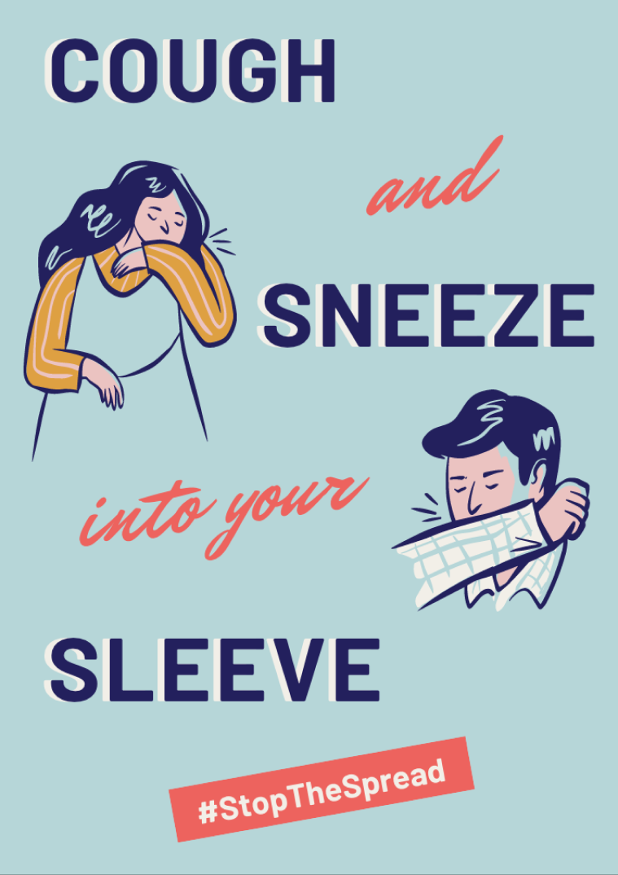
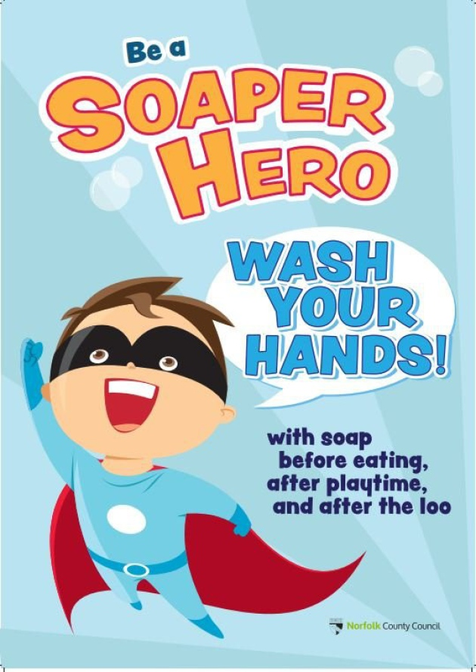
Extra Opportunities
There will be a lot to learn this year about safe behaviors including those that reduce the spread of illness.
Patrollers will have the opportunity to engage in extra leadership opportunities to keep our school environment safe.
These opportunities may take place virtually or in school.
Example:
Design a poster or lead a poster contest about
Hand washing
Sneezing into elbow vs. hand
Importance of social distancing in school and on the school bus

Slide 14
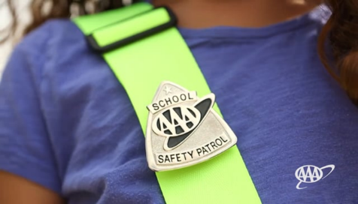
Be a Resource and Role Model
Protect yourselves while on duty by following the guidelines of your advisor.
Treat everyone with respect.
Practice good hygiene to help eliminate the spread of illness.
Continue to have fun and wear your belt and badge proudly!

Slide 15
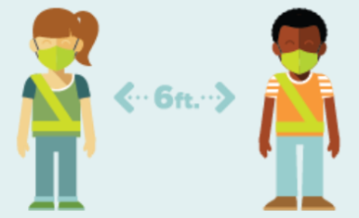
Final Reminder
Patrollers should not enforce the use of face coverings, social distancing or hand hygiene while on duty.
Patrollers can educate their peers on:
Why practicing good hygiene is essential
How to help reduce community spread of COVID-19
As a Patroller, show respect for the health and safety of those in your community and be a role model by practicing healthy habits while on duty.

Slide 16
Questions?

