Slide 1
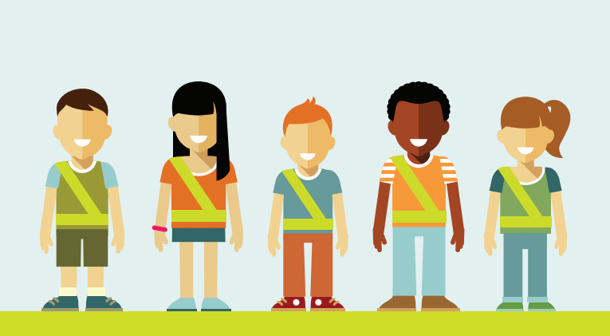
AAA School Safety Patrol
Patroller Training

Slide 2
**Presenter Notes**
**Prior to presenting, locate this slide on the left menu,
right click on the slide and select “Hide Slide” **
This presentation is intended for SCHOOL SAFETY PATROL ADVISORS to provide training for students chosen as Patrollers for the AAA School Safety Patrol Program.
This presentation includes:
Uniform and equipment care
Goal of the program
Defining a safety hazard
Qualities of a great Patroller
Training Exercises
How to communicate with others
Officer roles
Posts
AAA School Safety Patrol Pledge
Notes:
The AAA School Safety Patrol is about being a good leader and willing to work hard to help others. Many important individuals throughout our history started their first leadership position as a AAA School Safety Patroller.
AAA School Safety Patrol Famous Former Patrol Members
For some, being a member of the AAA School Safety Patrol is just the first step toward a career of public service and leadership. Former patrol members include:
Governors and Former Governors Bob Martinez, Florida James Blanchard, Michigan William Milliken, Michigan Lincoln Almond, Rhode Island
21 Astronauts, including: Norman E. Thagard, space endurance record holder Robert D. Cabana Mary Ellen Weber
U.S. Presidents/Vice Presidents Jimmy Carter, Bill Clinton, Joe Biden
U.S. Senator John W. Warner, Virginia
U.S. Supreme Court Justices & Former Justices Chief Justice Warren E. Burger, Anthony M. Kennedy, Stephen G. Breyer, Clarence Thomas, William J. Brennan, Jr.
Olympic Gold Medalists Caitlyn Jenner, decathlon Lynette Woodard, basketball Mike Ramsey, hockey Eric Heiden, speedskating Edwin Moses, track and field
Nobel Prize Winner Dr. Gary S. Becker, Economics
Government Andrew Card, Chief of Staff to George H. Bush and George W. Bush and former U.S. Secretary of Transportation U.S. Coast Guard Rear Admiral James C. Card, Office of Marine Safety,
Security and Environmental Protection Diane Steed, former administrator National Highway Traffic Safety Admin. Mike McCurry, former White House Press Secretary
Celebrities Joe Garagiola, Baseball Hall of Famer Tom Seaver, Baseball Hall of Famer Margaret Ay, Miss America 1954 Al Kaline, Baseball Hall of Famer Lee Iacocca, former Chairman Chrysler Corporation

Slide 3
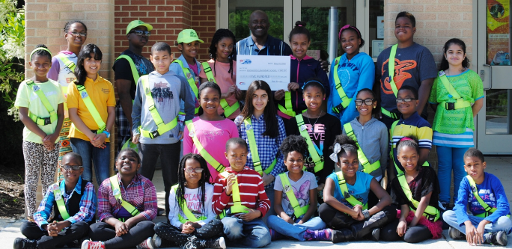
Welcome to the AAA School Safety Patrol!
You are now an important part of a group of 679,000 patrollers nationwide.

Slide 4
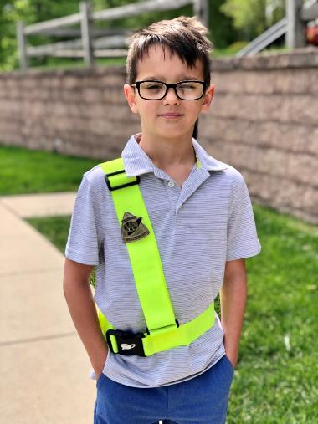
The Uniform
The Patroller uniform is composed of a belt and badge:
Belts should be worn over the right shoulder and buckled in the front.
Badge should be pinned on shoulder strap at chest level.
Only remove badge if belt is being cleaned (constant removing can break the pin).
Notes:
-It is recommended that belts/badges only be worn when the student is on post. It should be folded and stored in a designated area when not in use.
-Why are the belts so bright?
The “letric lime” color was chosen when the Federal Government changed the color of road signs related to pedestrians, bicycles, and school warning signs

Slide 5
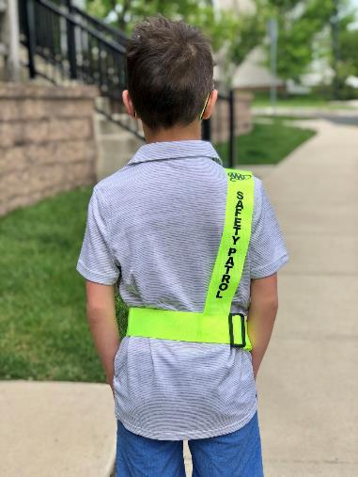
The Uniform
Why is the belt worn this way?
The words “Safety Patrol” should be positioned on your back so anyone behind you can identify you as part of the patrol.
The badge on the front shows anyone facing you that you are part of the patrol.

Slide 6
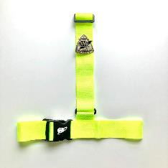
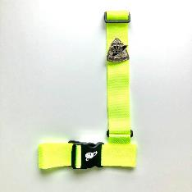
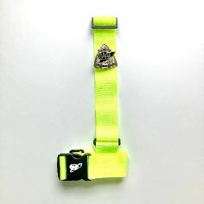
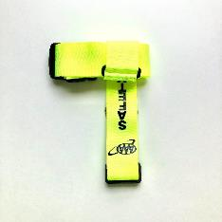
1
Folding the Patrol Belt
2
3
4
Notes:
Have a belt and show the students how it’s done.
Beginning with your patrol belt laying on a flat surface, match the waist portion of the belt together and then the shoulder portion of the belt together. It will look like an upside down T.
2. Fold under the right side of the waist portion of the belt.
3. Fold under the left side of the of the waist portion of the belt.
4. Fold under the shoulder portion of the belt so it wraps around the belt waist until folded completely.
Secure with a rubber band or place it in a plastic sandwich bag.

Slide 7
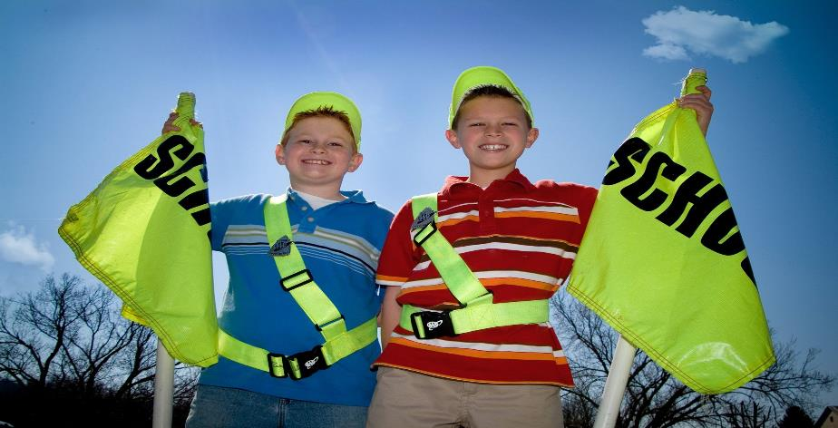
The Goal
To create a safe school environment by identifying safety hazards and being willing to help those in need.

Slide 8
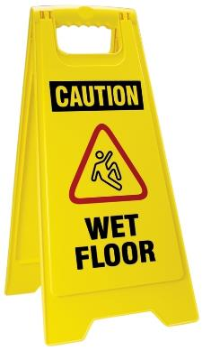
What is a safety hazard?
A spill on the floor
A bee or wasp nest on the playground
Running in the halls
A stranger that doesn’t belong at the bus stop or near school
A fight amongst students
An animal that looks sick or isn’t normally around
Rough housing at the bus stop

Slide 9
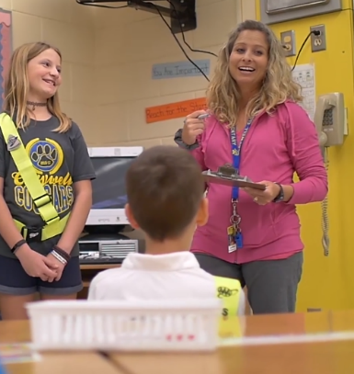
What to do in an unsafe situation:
Use your best judgement.
Find the nearest adult and ask for help.
If there’s not an adult nearby, stay with the student(s) in trouble and ask a peer to get an adult .
For example: a student falls, hurts their ankle, and cannot walk

Slide 10
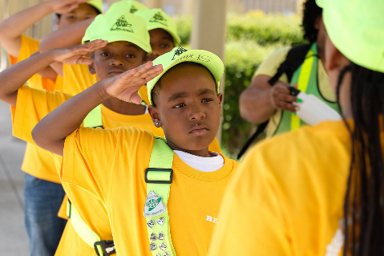
Qualities of a Great Patroller
Models safe behavior at all times
Friendly and approachable
Willing to help others
Dependable

Slide 11
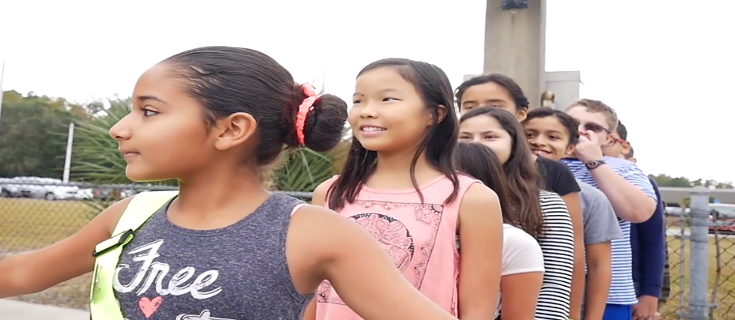
A Great Patroller is NOT:
Bossy
Mean to fellow patrollers
Disrespectful to teachers or adults
One who believes they are better or have more power because they are a patroller

Slide 12
Earn Respect
Body Language: Stay alert at your post, wear your belt and badge proudly, and use body language that is welcoming.
Tone of Voice: Saying the exact same words but with different tones may be perceived very differently. Use a firm but kind tone.
Words: PLEASE and THANK YOU. Instead of saying “Don’t run!” try the opposite, “Please walk.”

Slide 13
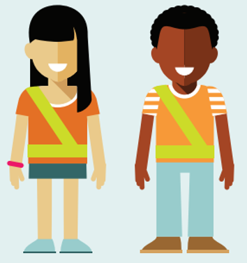
Trainee Exercise
Remember when you were in kindergarten?
One situation, but two very different ways to handle it.
Notes:
Trainee volunteer. “Remember when you were in Kindergarten or 1st grade how LARGE the 5th graders were? That’s you now! You are giants to them.”
Lets pretend that I (adult) is the 5th grade patroller and you (trainee) is the kindergartner. My job is to keep students safe in the hallway and you are running by.
#1 - [Pretend] intimidating posture, “STOP OR I’LL TELL ON YOU!!! I’M A SAFETY PATROLLER!”
Will “kindergartner” stop running? Maybe, because they will be scared of you.
#2 - Better option, “Hi that is an awesome backpack, sneakers, sticker (etc.). I’m Mary. What is your name? (shake hand). [Small talk] Hey, can you please do me a favor and not run in the hallways? I don’t want to see you get hurt. Thank you. Have a good rest of the day. [high five – but not during COVID].”

Slide 14
Trainee Exercise
Differences between style #1 and #2?
What if it doesn’t work?
Notes:
Ask trainees differences between #1 and #2
Asked name, said please and thank you, told them my name, shook hands, asked them something about them, respect, etc.
Sounds like? Making a new friend. How cool would you have been in kindergarten if you had a friend in the 5th grade?
Will the kindergartner listen now? Still maybe, but you may have someone who will look up to you and want to keep you happy. If it works they may still need reminders from time to time. They may even get their classmates to behave because their friend in the SSP is looking out for them.

Slide 15
Trainee Exercise
Tips:
When this doesn’t work
Best source for new ideas
Secret “tips” for patrollers
Notes:
Will this work every time? Definitely not. If it doesn’t work, tweak it a little and try again, keep tweaking it until it works a little, then expand on that
If you are trying everything you can think of and its not working, tell on them? No, first talk to your other patrollers and put your heads together. Next, ask advisor for ideas.
Little secret:
SSP boy talking nicely to kindergarten girl – she is probably going to blush a little
SSP girl talking nicely to k’garten boy – he is DEFINITELY going to blush – haha
The main takeaway - #1 is a boss, #2 is a leader. Talk about the differences between those. Being boss is easy. Leadership takes practice. SSP is for leaders.

Slide 16
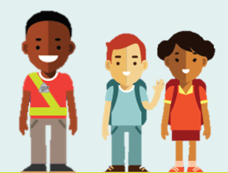
How to communicate safe behaviors:
1. Politely ask the student(s) to stop the unsafe behavior
2. Add BECAUSE
3. Say THANK YOU especially if they listen
4. If the student(s) don’t listen:
Ask again firmly
Never lose your cool
If they still don’t stop, notify your advisor
Notes:
1. Always be polite and courteous. Treat others the way you would like to be treated
2. Adding “because” is more impactful to explain why the activity is unsafe instead of merely saying, “Stop!”
3. You can never say thank you enough
4. Many schools institute a 3 warning policy where if the patroller cannot get the student to stop after 3 attempts (can be over time), then they report to their advisor/specific adult

Slide 17
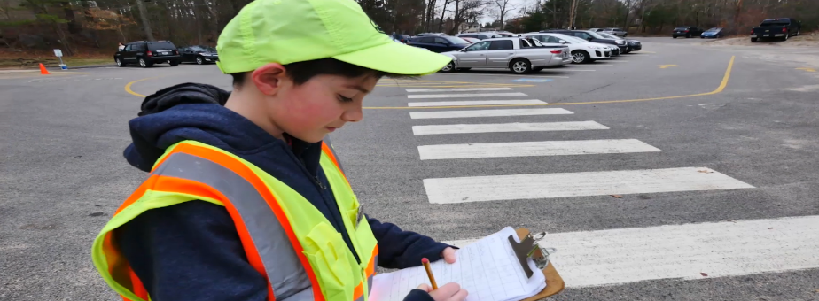
Officers of the Patrol
Additional jobs are assigned to those patrollers chosen as Captain, Lieutenant, and Sergeant
For Example:
Ensure all patrollers are at their posts
Report absences and arrange for substitutes
Meeting agendas
Attendance
Ensure all equipment is clean and in working order

Slide 18
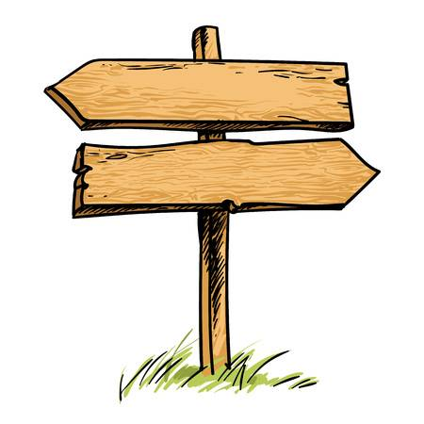
Types of Posts
Outside Post
Inside Post

Slide 19
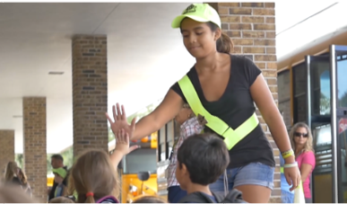
Hallway & Door Posts
Ensure students enter and exit doors without pushing or running.
Remind students to walk, use the right side of the hallway, and use caution at any stairwell.
Assist younger students who may need help getting to class.

Slide 20
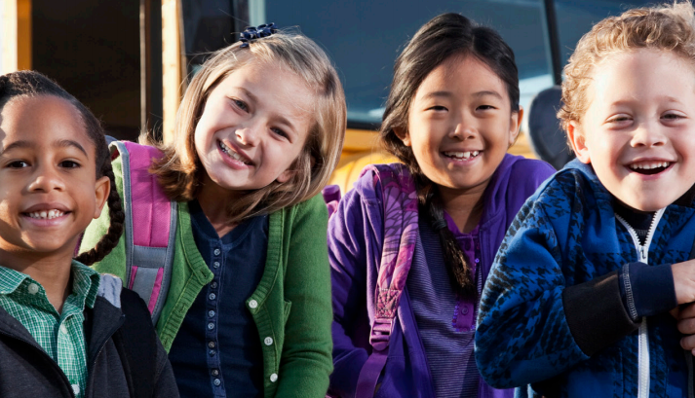
Kindergarten Escort Posts
Keep them in view at all times
Make sure they stay away from traffic
Stay with them until they reach their destination

Slide 21
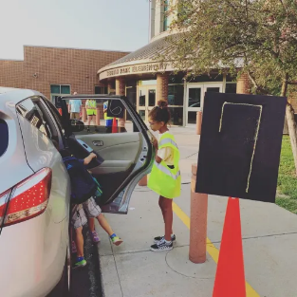
Car Rider Posts
Help students enter/exit their vehicle safely.
Encourage students to exit and move away from car line as they walk toward the building.
Make sure no students reach under any vehicle to retrieve an item that may have fallen or blown away.
NEVER direct traffic.

Slide 22
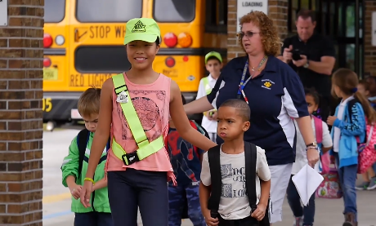
School Bus Posts
Follow all bus rules
Stay seated
Be alert to any safety hazards
Notify the driver if there is an emergency

Slide 23
Reminders to Keep YOU Safe
Never direct traffic.
Don’t approach or allow others to approach unknown drivers.
Don’t help strangers with directions.
Never give out personal information like your name, address, or phone number to unknown adults.

Slide 24
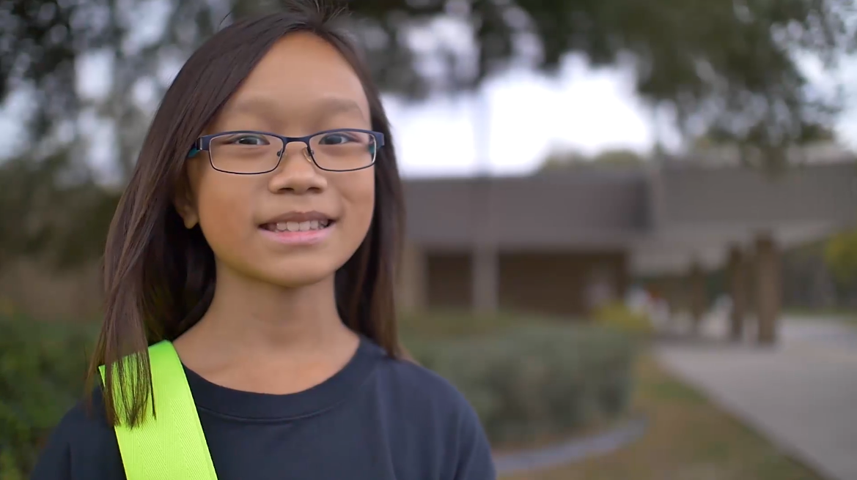
Final Reminders
Always be respectful and alert.
Pay attention 100% when at your post.
Never allow yourself to get angry with others.
Look to adults to handle issues beyond your control.
Be proud of your role.

Slide 25
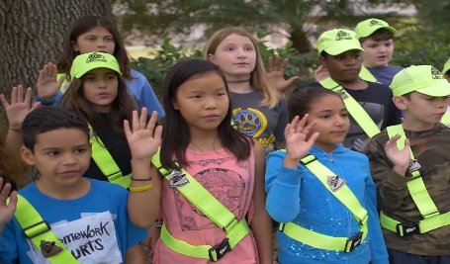
AAA Safety Patrol Pledge
I promise to do my best to:
Report for duty on time,
Perform my duties faithfully,
Strive to prevent injuries, always setting a good example myself,
Obey my teachers and officers of the patrol,
Report dangerous student practice,
Strive to earn the respect of fellow students.

Slide 26
Congratulations & good luck!

